Slide 1
Web and Network Security: HTTPS CS-4440 - Introduction to Computer Security Spring 2022 Jun Xu Slides adapted from CS142 by Dan Boneh at Stanford and CSE343/443 by Yinzhi Cao at Lehigh

Slide 2
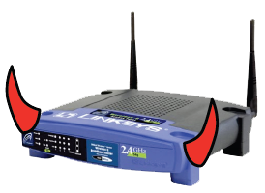
Threat Model: Network Attacker
Network Attacker:
Controls network infrastructure: Routers, DNS
Passive attacker: only eavesdrops on net traffic
Active attacker: eavesdrops, injects, blocks, and modifies packets
Examples:
Wireless network at Internet Café
Internet access at hotels (untrusted ISP)

Slide 3
Solution in Reality: SSL/TLS
Public-key encryption:
Alice
Bob
m
Enc
c
c
Dec
m
PK_{Bob}
SK_{Bob}
Bob generates (SK_{Bob} , PK_{Bob} )
Alice: using PK_{Bob} encrypts messages and only Bob can decrypt

Slide 4
SSL/TLS History
SSL – Secure Socket Layer
TLS – Transport Layer Security
both provide a secure transport connection between applications (e.g., a web server and a browser)
SSL was developed by Netscape
SSL version 3.0 has been implemented in many web browsers (e.g., Netscape Navigator and MS Internet Explorer) and web servers and widely used on the Internet
SSL v3.0 was specified in an Internet Draft (1996)
it evolved into TLS specified in RFC 2246
TLS can be viewed as SSL v3.1

Slide 5
What’s New Here Compared to Secure Communications? How Is It Actually Implemented???

Slide 6

Certificates
How does Alice (browser) obtain PK_{Bob} ?
Browser Alice
Server Bob
CA
choose
(SK,PK)
PK and
proof “I am Bob”
check
proof
PK_{CA}
PK_{CA}
SK_{CA}
issue Cert with SK_{CA} :
verify
Cert
Bob’s key is PK
Bob’s key is PK
Bob uses Cert for an extended period (e.g., one year)

Slide 7
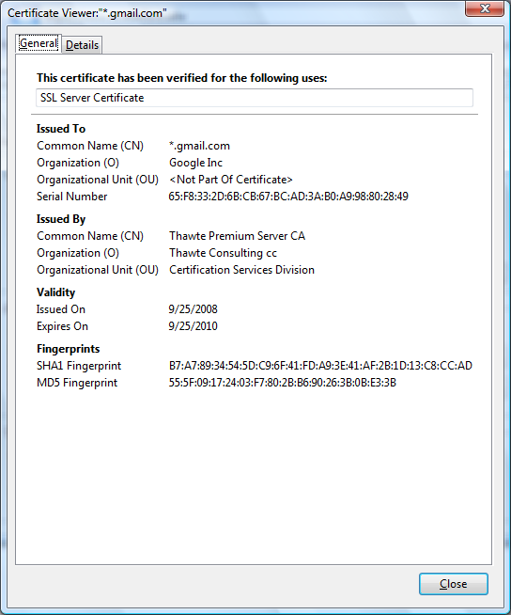
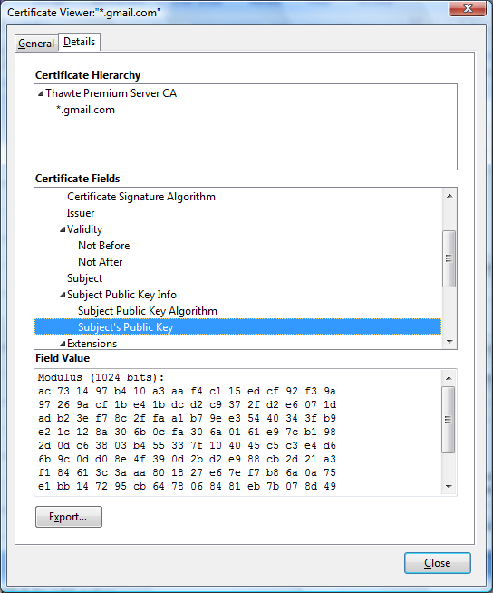
Certificates: example
Important fields:

Slide 8
Certificates on the web
Subject’s CommonName can be:
An explicit name, e.g. cs.stanford.edu , or
A name with a wildcard character, e.g.
*.stanford.edu or cs*.stanford.edu
matching rules:
IE7: “*” must occur in leftmost component, does not match “.”
example: *.a.com matches x.a.com but not y.x.a.com
FF3: “*” matches anything

Slide 9
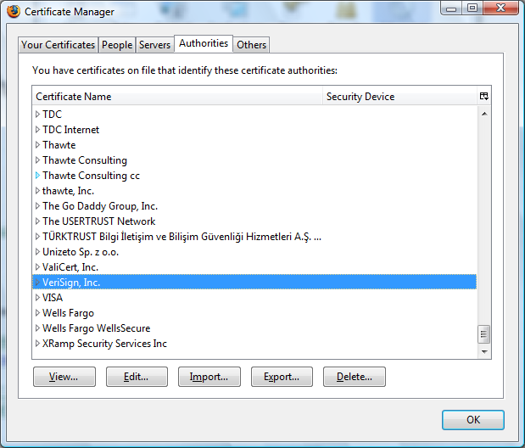
Certificate Authorities
Browsers accept certificates from a large number of CAs

Slide 10
Brief overview of SSL/TLS
browser
server
client-hello
cert
server-hello + server-cert (PK)
SK
key exchange (several options)
rand. k
client-key-exchange: E(PK, k)
k
Finished
HTTP data encrypted with KDF(k)
Most common: server authentication only

Slide 11
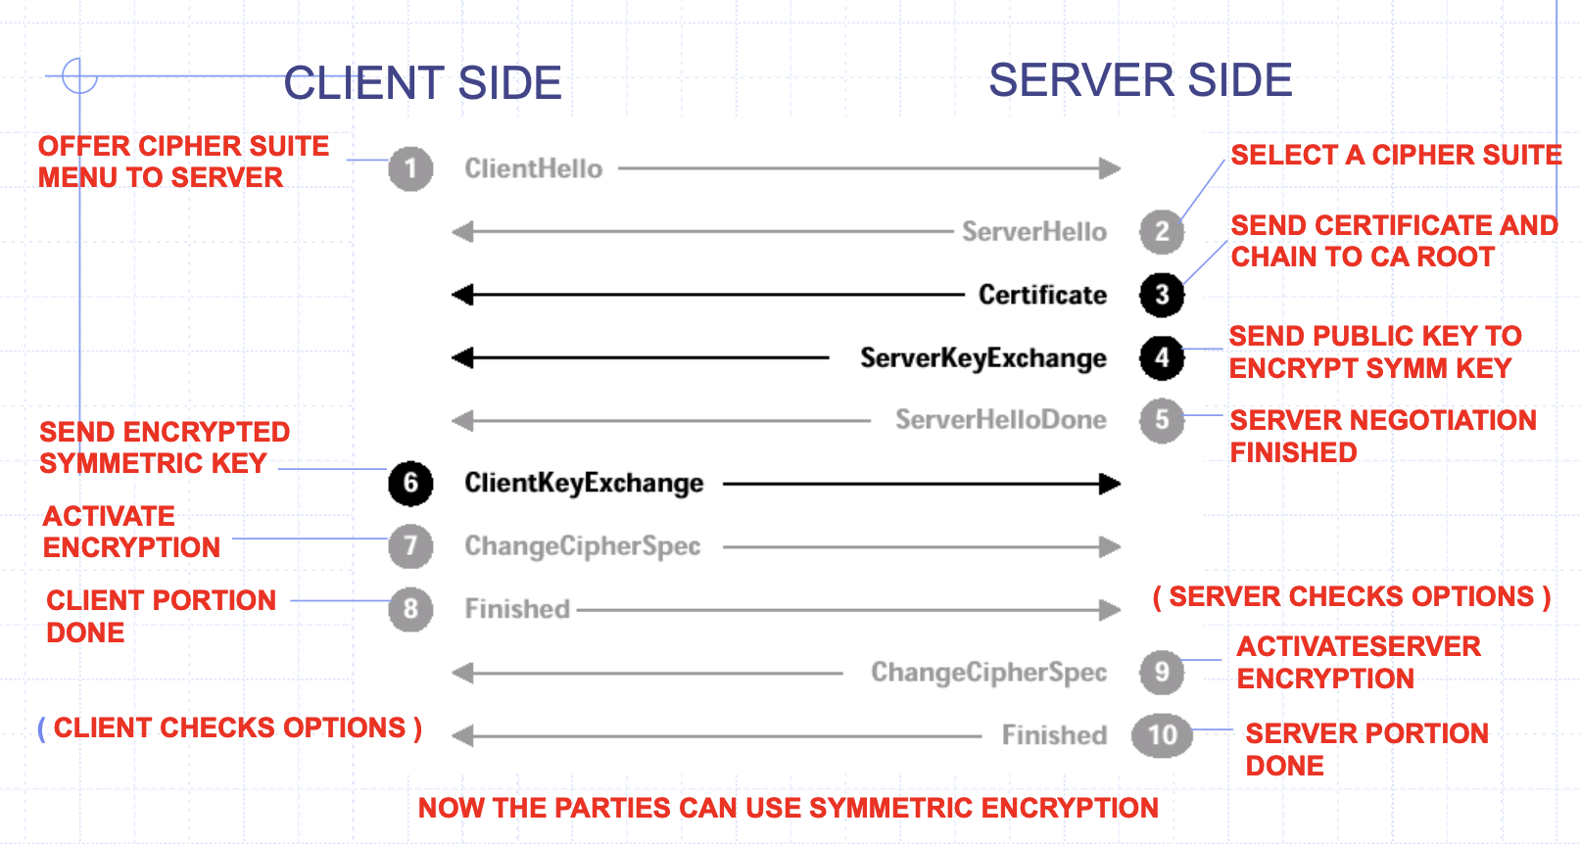
A More Detailed View

Slide 12
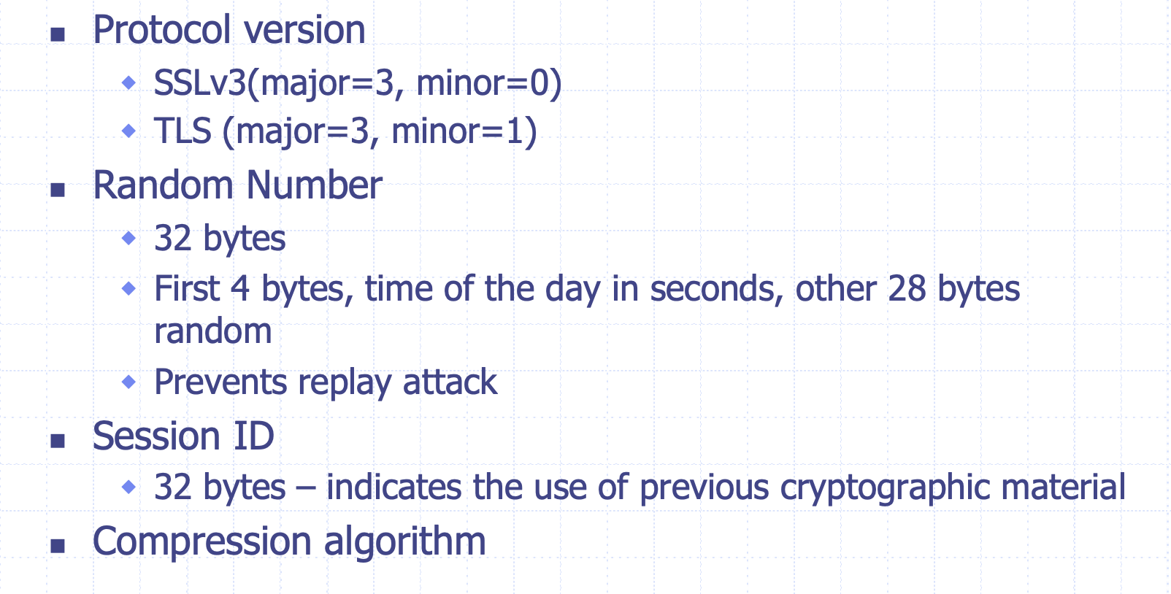
Client Hello

Slide 13
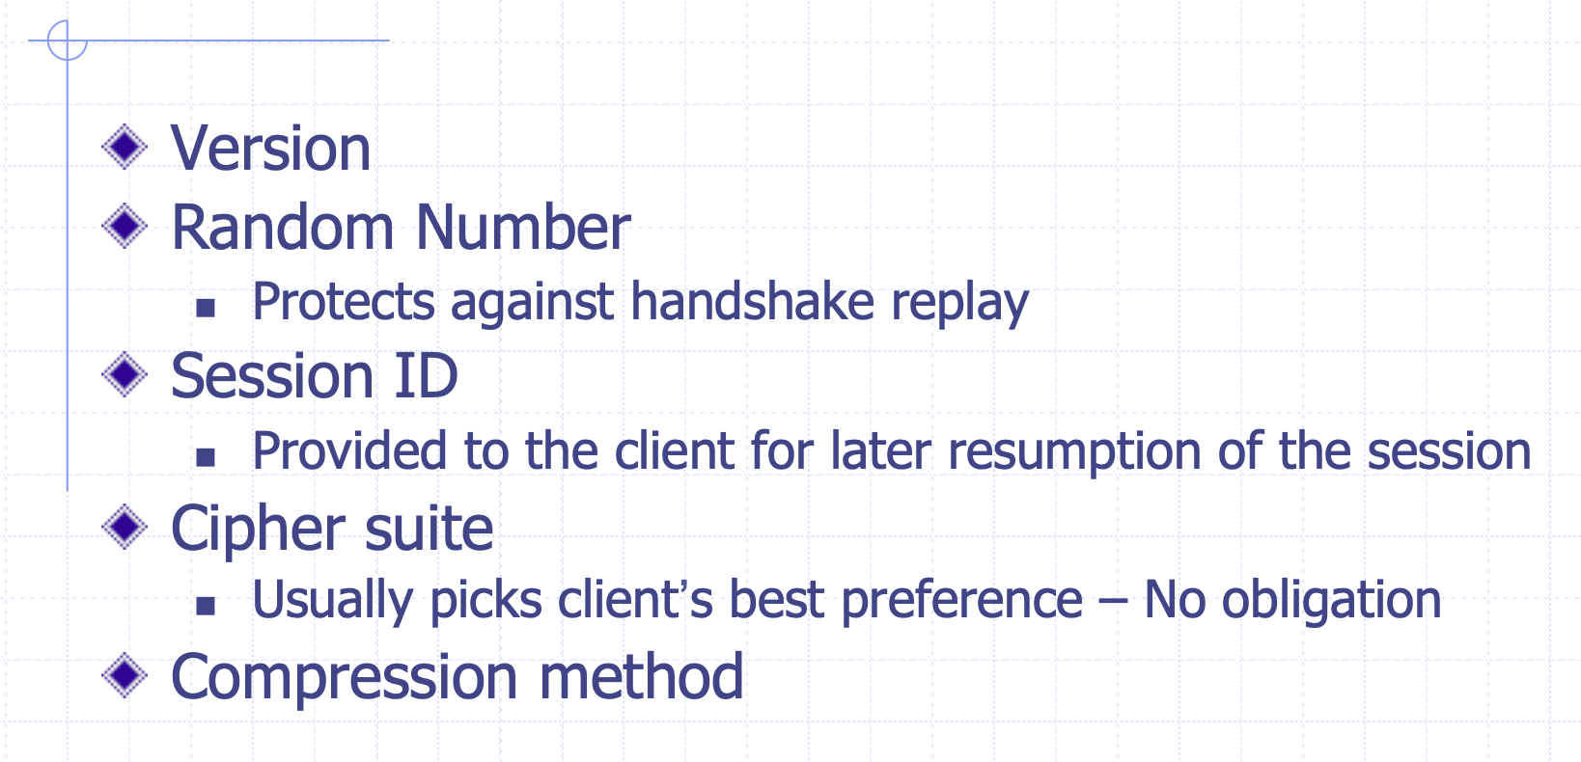
Server Hello

Slide 14
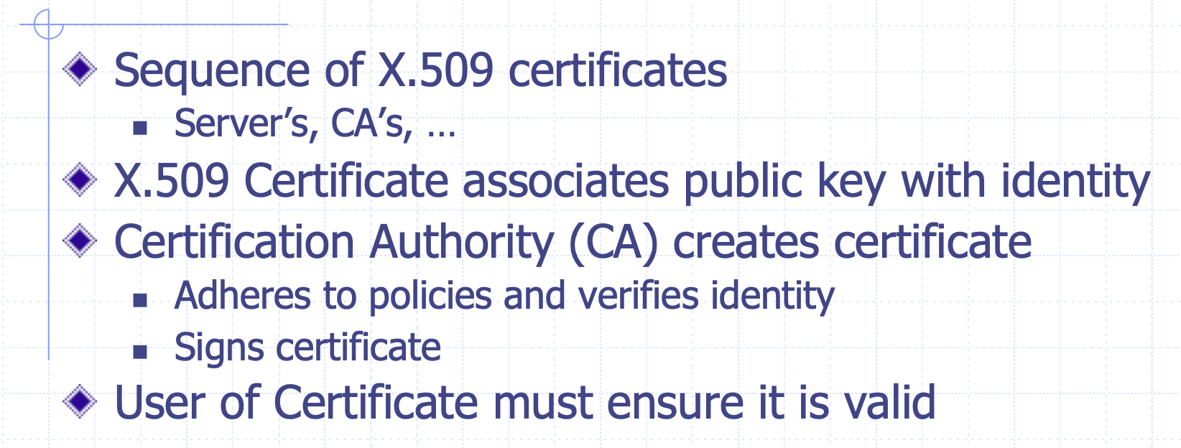
Certificates

Slide 15
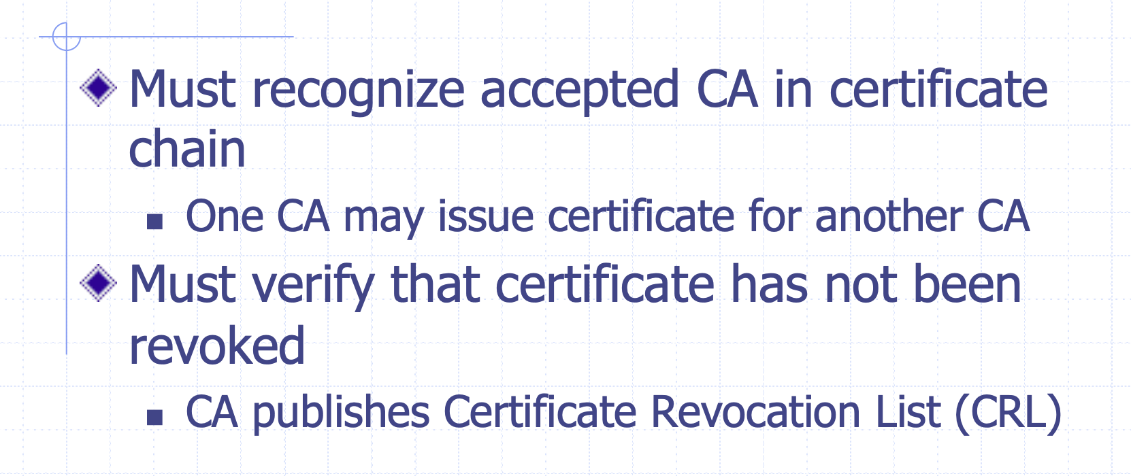
Validating A Certificate

Slide 16
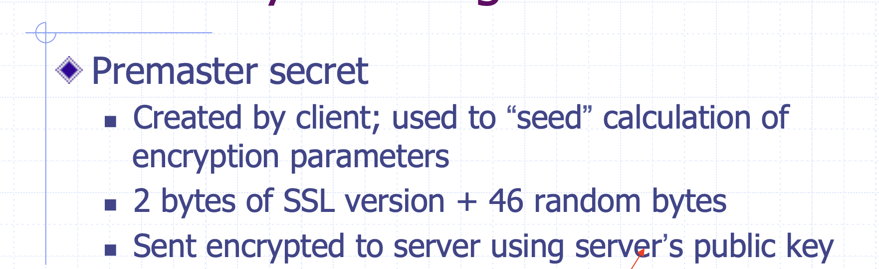
Client Key Exchange

Slide 17
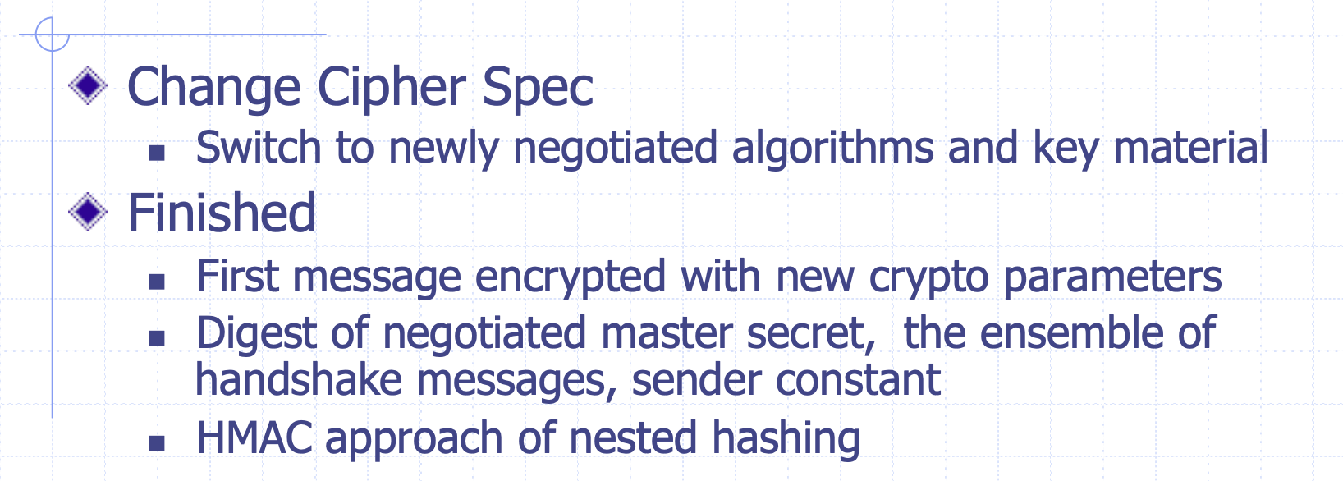
Change Cipher Spec & Finished Messages

Slide 18
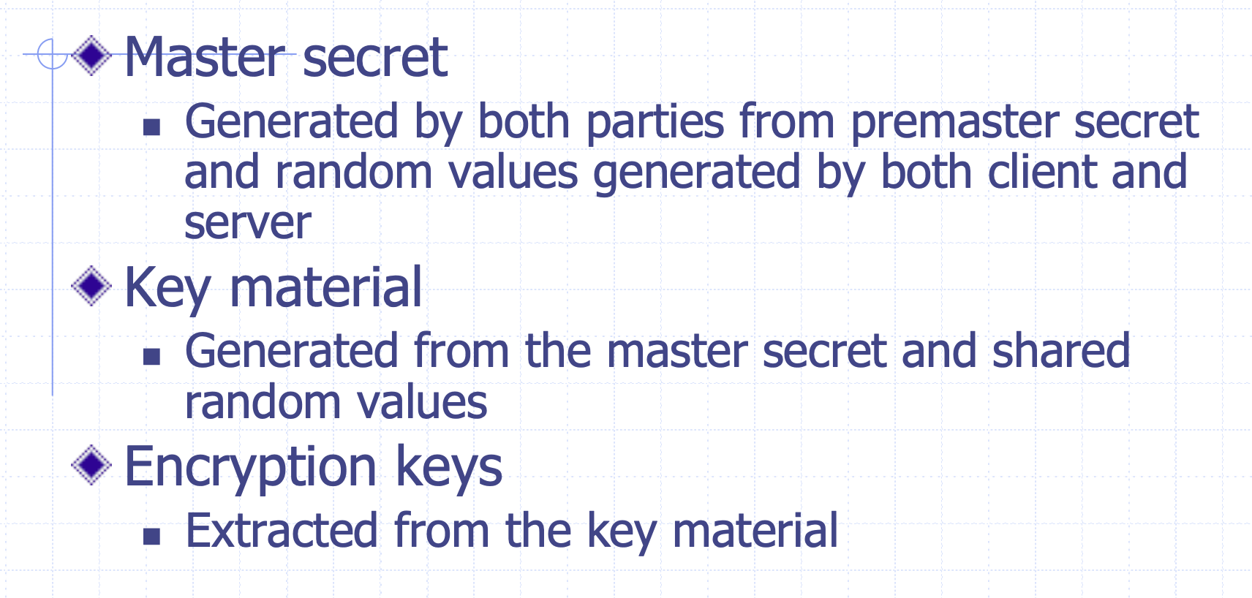
SSL Encryption

Slide 19
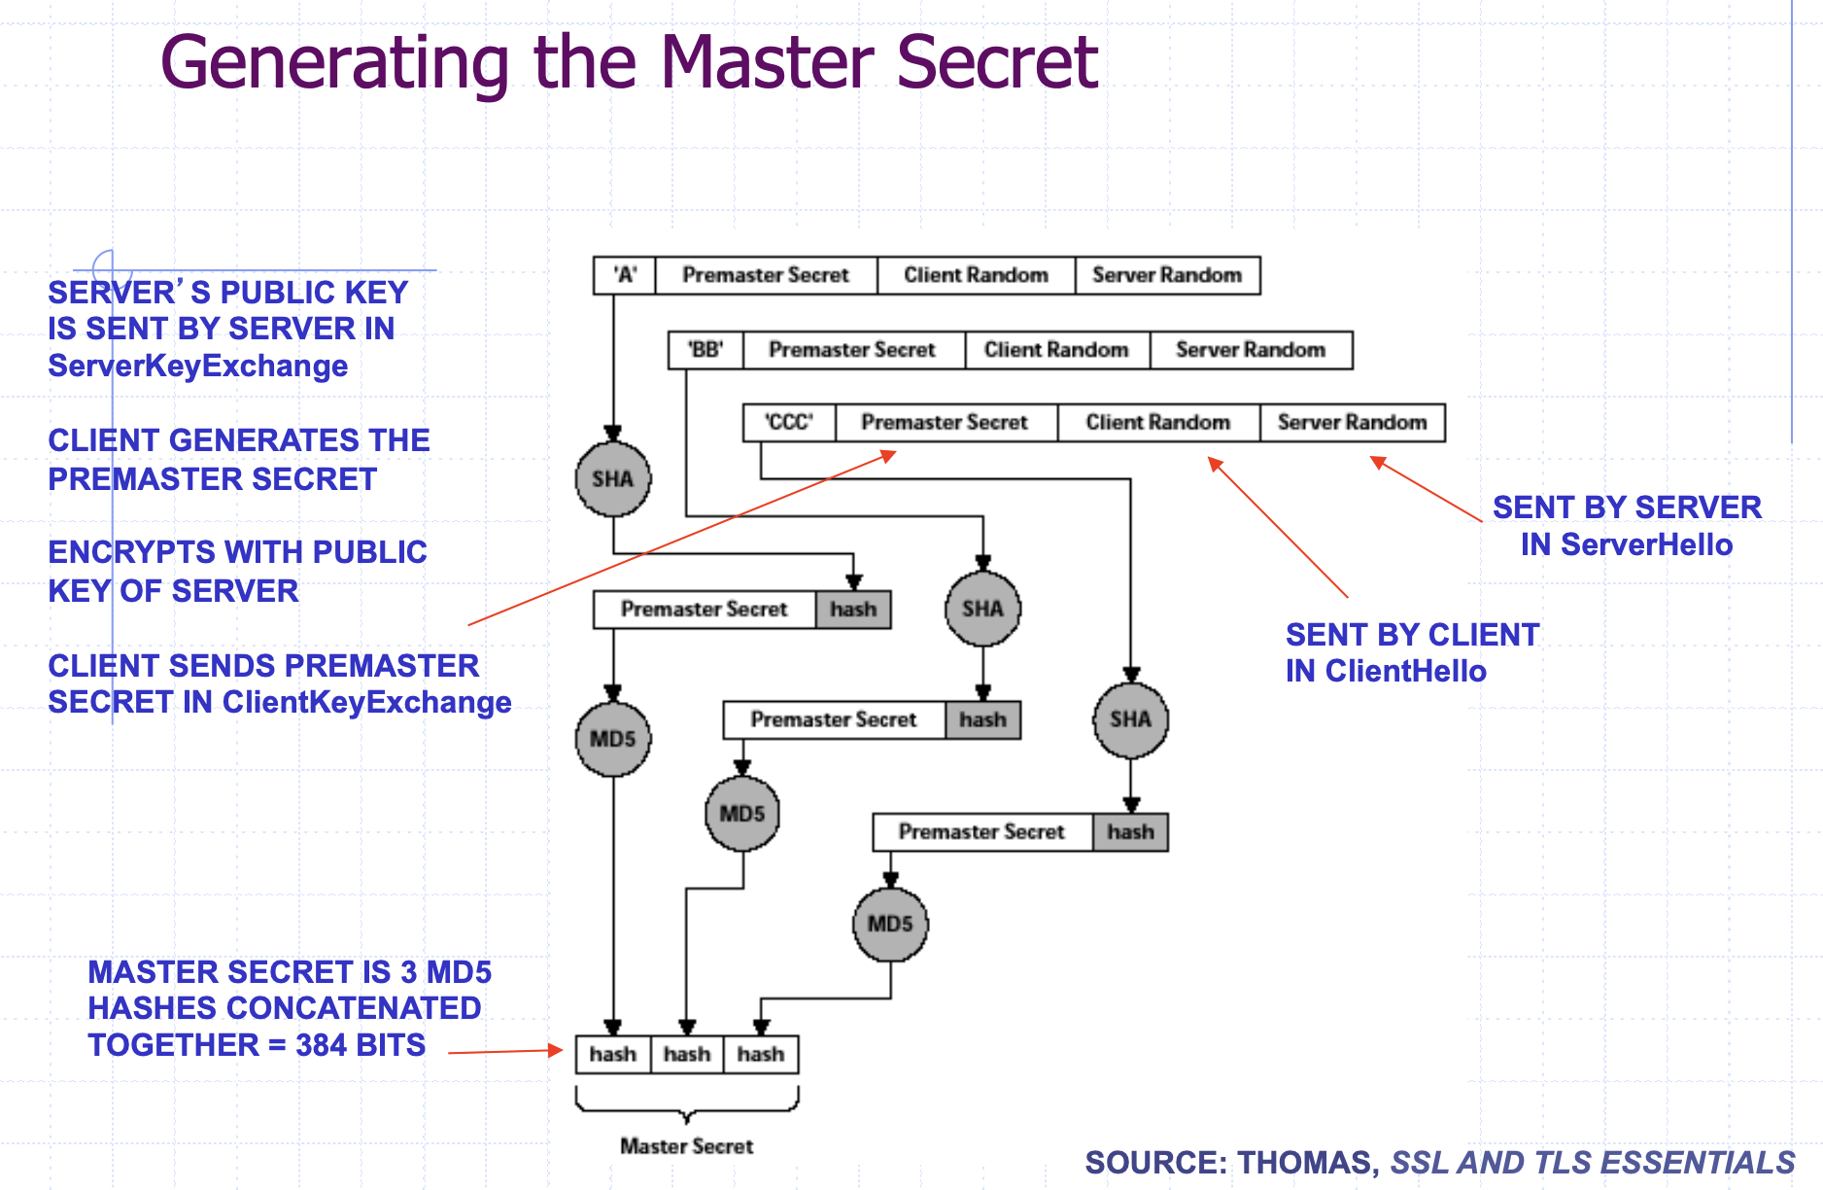

Slide 20
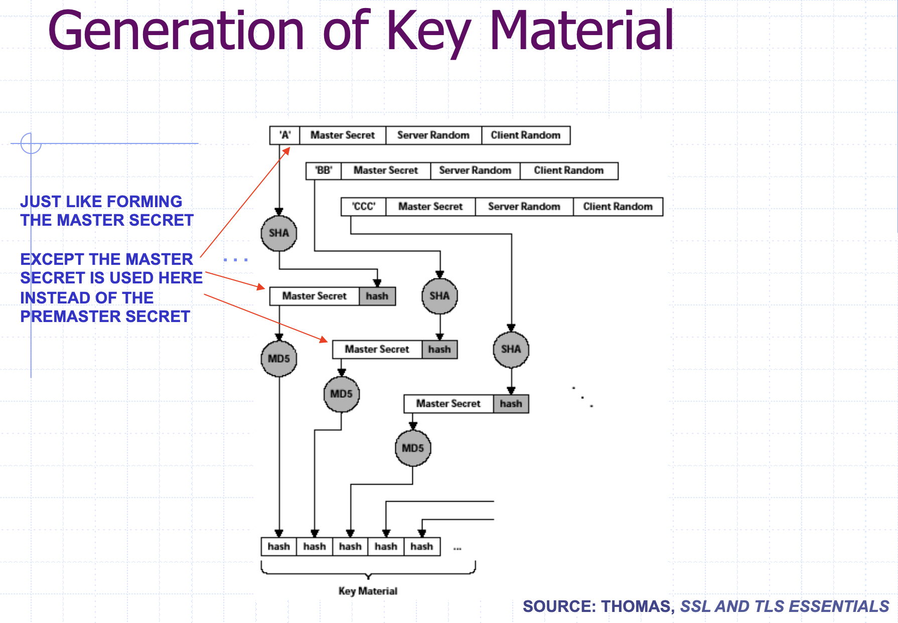

Slide 21
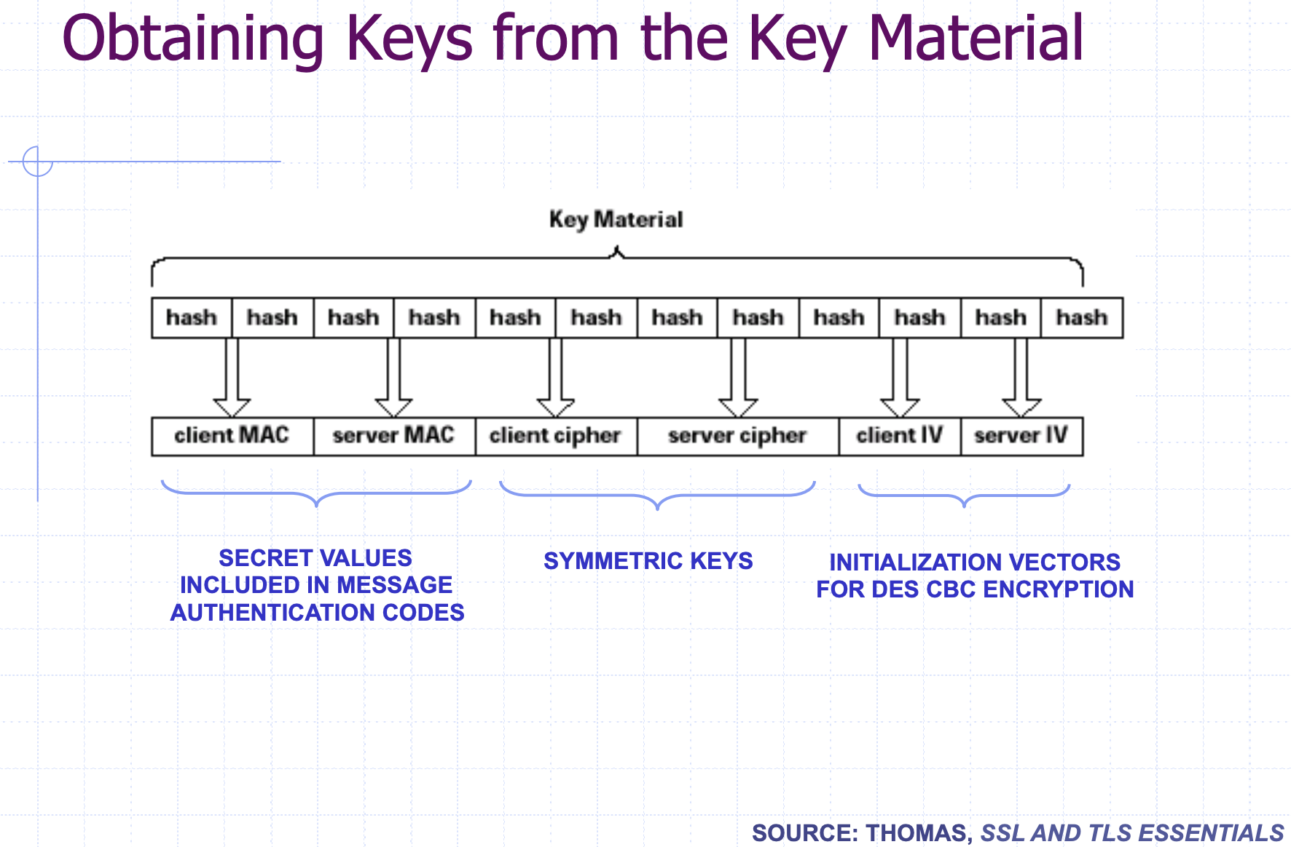

Slide 22
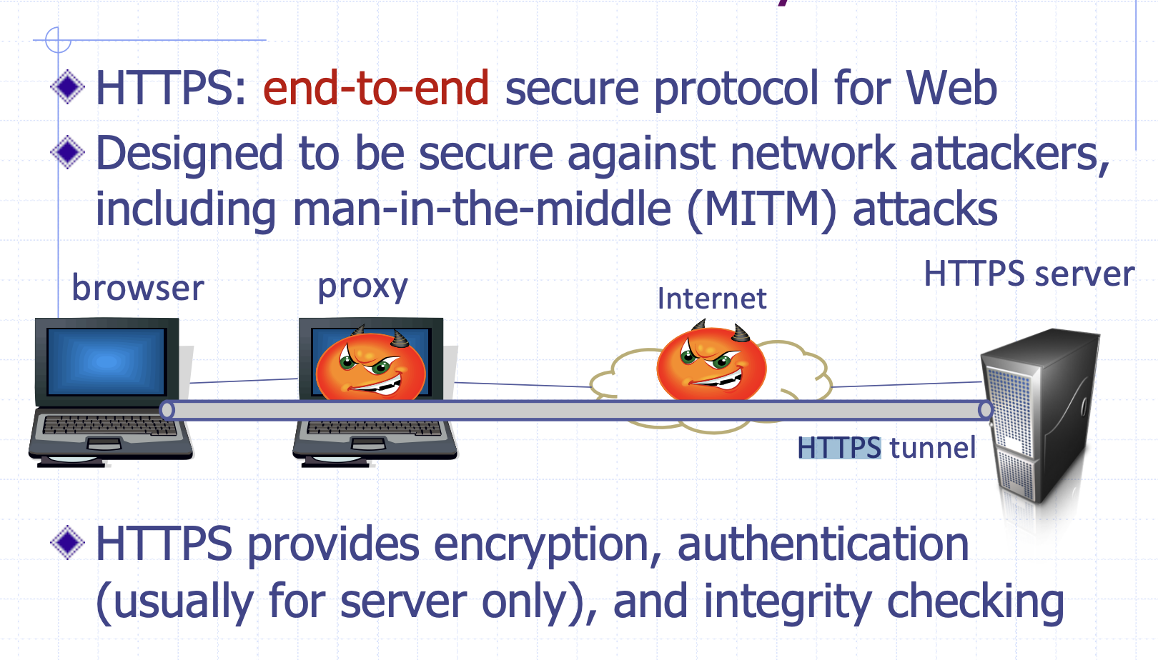
SSL/TLS for the Web: From HTTP to HTTPS

Slide 23
Practical Barriers of HTTPS
web proxy
web server
Two practice complications
Web proxies
solution: browser sends
CONNECT domain-name
before client-hello (dropped by proxy)
Virtual hosting:
two sites hosted at same IP address.
solution in TLS 1.1 (RFC 4366)
client_hello_extension: server_name=cnn.com
implemented in FF2 and IE7 (vista)
corporate network
web server
client-hello
server-cert ???
cert_{CNN}
cert_{FOX}

Slide 24
Practical Barriers of HTTPS Cont.
Slows down web servers
Breaks Internet caching
ISPs (i.e., dedicated network server that saves the regularly requested web content by keeping it in temporary storage) cannot cache HTTPS traffic
Results in increased traffic at web site

Slide 25
HTTPS in the Browser

Slide 26
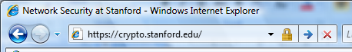
The lock icon: SSL indicator
When all elements on the page fetched using HTTPS
HTTPS cert issued by a CA trusted by browser
HTTPS cert is valid (e.g., not expired)
CommonName in cert matches domain in URL
Intended goal:
Provide user with identity of page origin
Indicate to user that page contents were not viewed or modified by a network attacker
Notes:
Network attacker: controls routers, DNS; can inject, delete, and modify packets

Slide 27
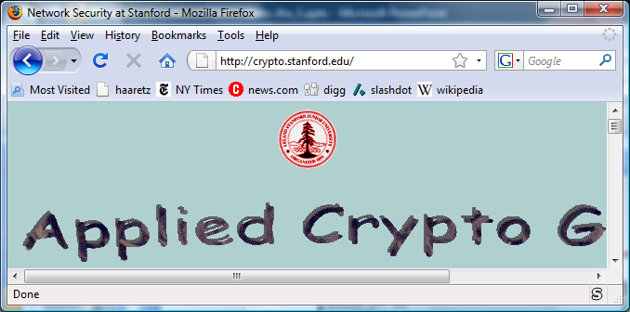
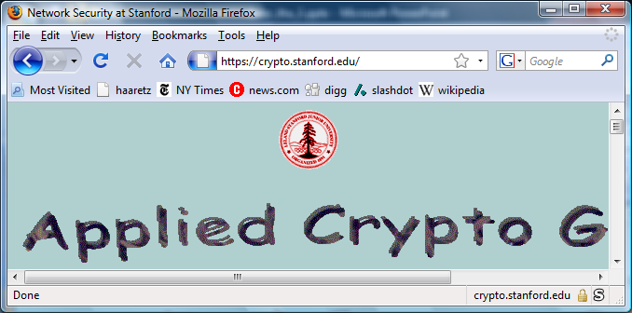
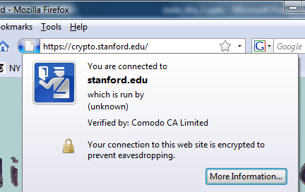
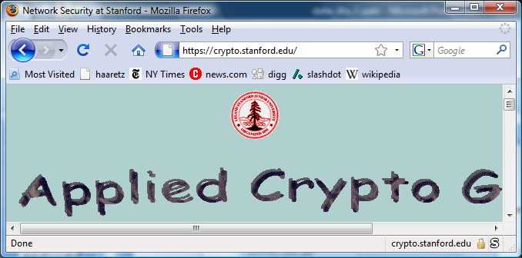
The lock UI: help users authenticate site
Firefox 3:
(no SSL)
(SSL)
Notes:
Click on fav icon gives pop-up on bottom.

Slide 28
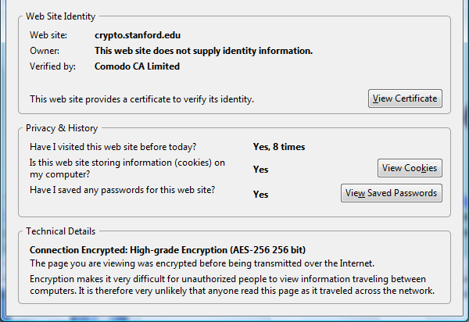
The lock UI: help users authenticate site
Firefox 3: clicking on bottom lock icon gives

Slide 29
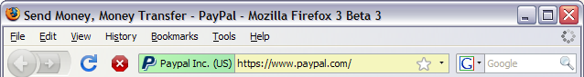
The lock UI: Extended Validation (EV) Certs
Designed for banks and large e-commerce sites
Harder to obtain than regular certs
requires human lawyer at CA to approve cert request

Slide 30
Problems with HTTPS and the Lock Icon

Slide 31
Problems with HTTPS and the Lock Icon
Upgrade from HTTP to HTTPS
Semantic attacks on certs
Invalid certs
Mixed content
HTTP and HTTPS on the same page
Origin contamination
Weak HTTPS page contaminates stronger HTTPS page

Slide 32
1. HTTP → HTTPS upgrade
Common use pattern:
browse site over HTTP; move to HTTPS for checkout
connect to bank over HTTP; move to HTTPS for login
Easy attack: prevent the upgrade (ssl_strip) [Moxie’08]
When users visit a website, they first connect with the HTTP version before getting rerouted to the HTTPS version. In SSL stripping attacks, hackers jump in this window to act as a man in the middle and prevent users from ever connecting with the HTTPS version of the site.
HTTP
SSL
attacker
web server
Notes:
ssl_strip: prevents browser from upgrading, but does the SSL upgrade when communicating with the server. Server has no idea this is taking place.

Slide 33
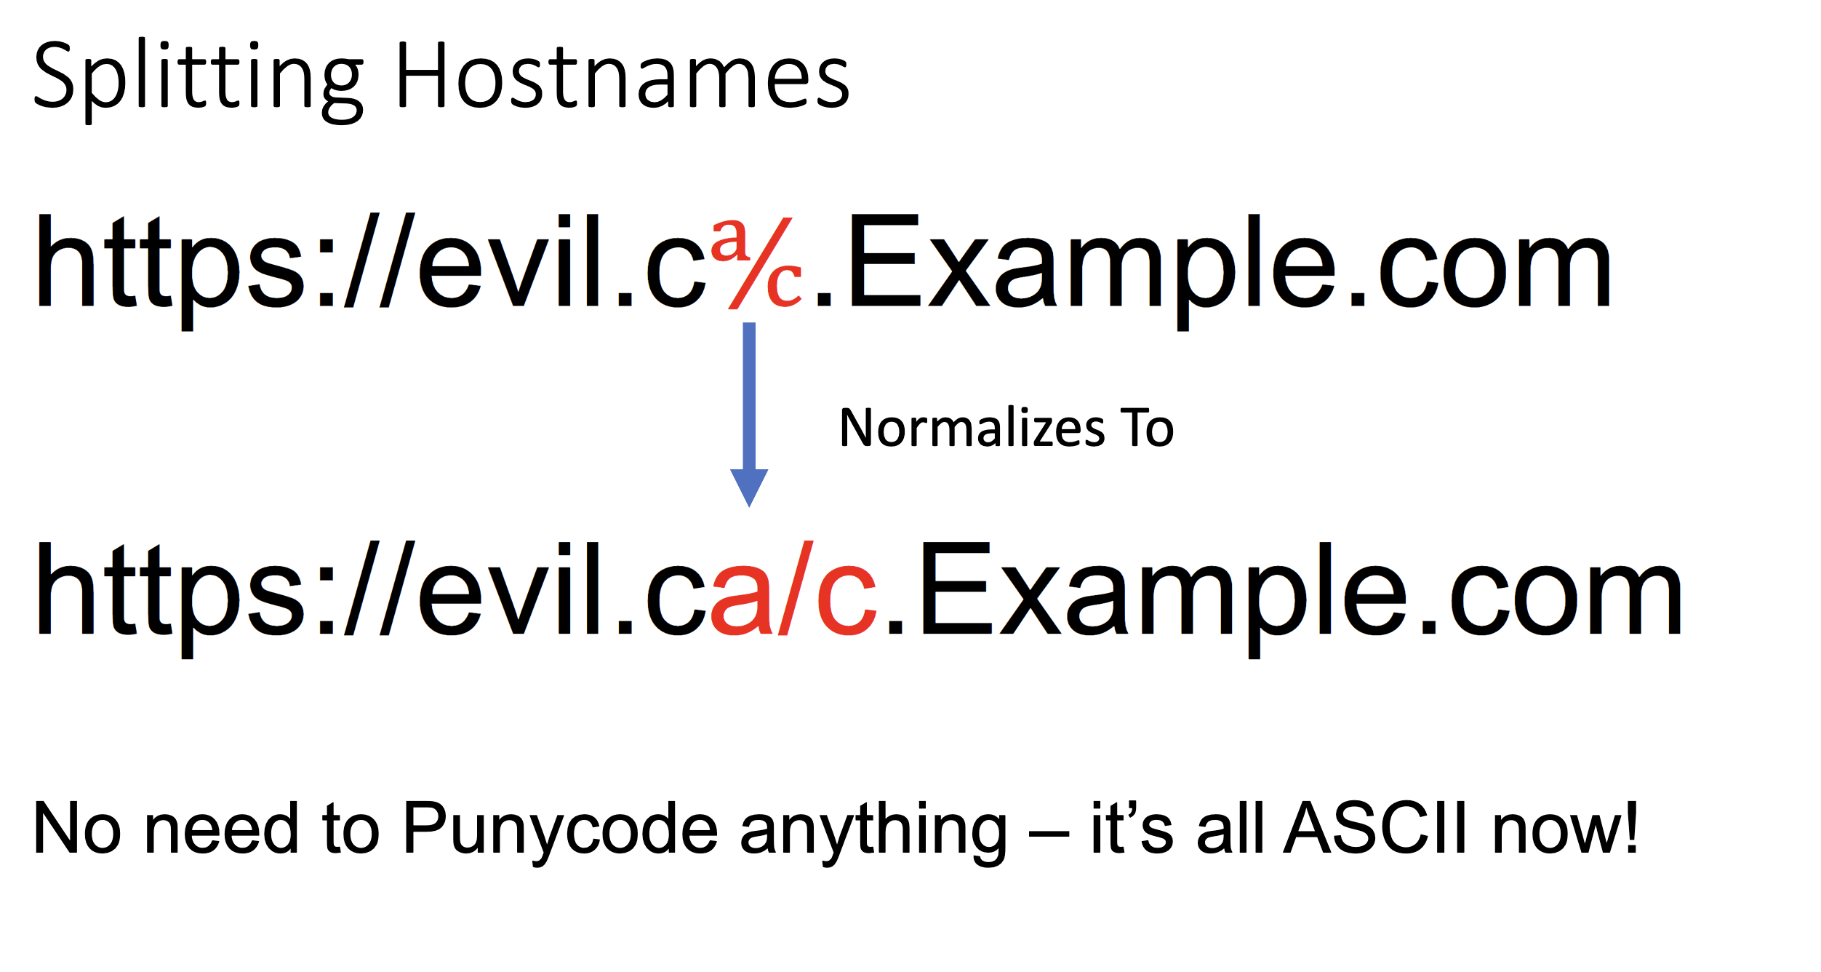
2. Semantic attacks on certs
Example: Chinese character set contains chars that look like “/” and “?” and “.” and “=”
Attack: the benign domain name is A and the malicious domain name is A’; Due to erroneous handling of special symbols in the code, A is interpreted as A’

Slide 34
3. Invalid certs
Examples of invalid certificates:
expired: current-date > date-in-cert
CommonName in cert does not match domain in URL
unknown CA (e.g. self signed certs)
Small sites may not want to pay for cert
Users often ignore warning:
Is it a misconfiguration or an attack? User can’t tell.
Accepting invalid cert enables man-in-middle attacks (see http://crypto.stanford.edu/ssl-mitm )

Slide 35
Man in the middle attack using invalid certs
GET https://bank.com
BadguyCert
BankCert
attacker
ClientHello
ClientHello
bank
ServerCert (Badguy)
ServerCert (Bank)
bad cert
warning!
SSL key exchange
SSL key exchange
k₁
k₁
k₂
k₂
HTTP data enc with k₁
HTTP data enc with k₂
Attacker proxies data between user and bank. Sees all traffic and can modify data at will.

Slide 36
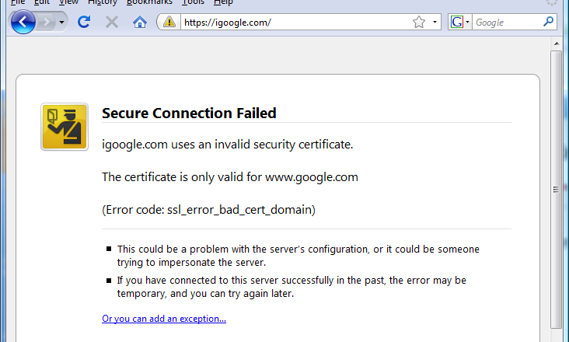
Firefox: Invalid cert dialog
Firefox 3.0: Four clicks to get firefox to accept cert
page is displayed with full HTTPS indicators

Slide 37
4. Mixed Content: HTTP and HTTPS
Page loads over HTTPS, but contains content over HTTP
(e.g. <script src=“http://.../script.js> )
IE7: displays mixed-content dialog and no SSL lock
Firefox 3.0: displays `!’ over lock icon (no dialog by default)
Safari: does not attempt to detect mixed content

Slide 38
Mixed content and network attacks
banks: after login all content served over HTTPS
Developer error: somewhere on bank site write
<embed src=http://www.site.com/flash.swf>
Active network attacker can now hijack session
Better way to include content:
<embed src=//www.site.com/flash.swf>
served over the same protocol as embedding page

Slide 39
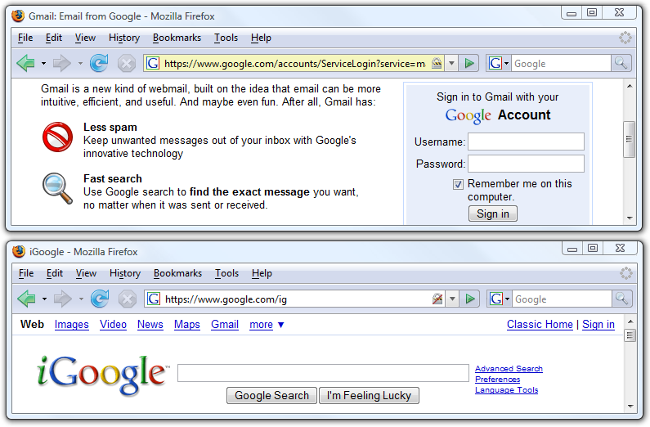
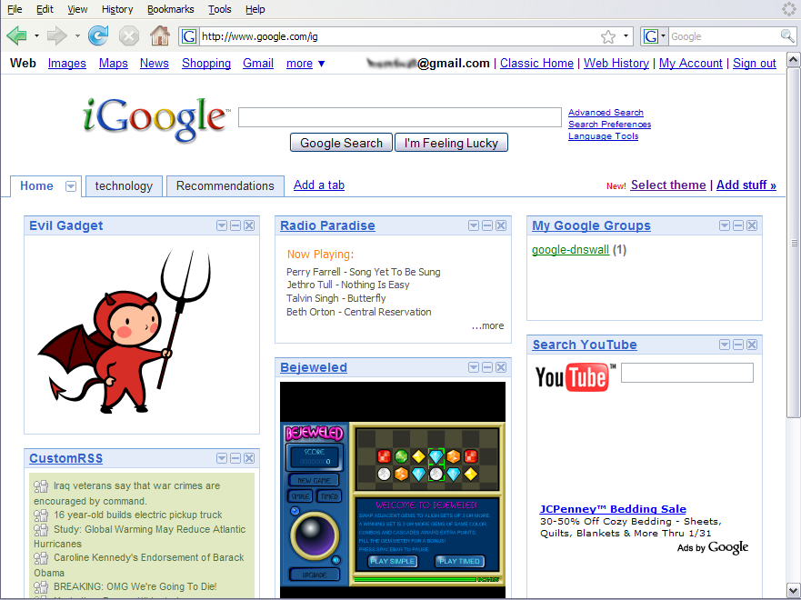
5. Origin Contamination: an example
Notes:
Broken SSL page can be used to take over a good SSL page: both are in the same origin.
Similar problem with EV certs: non-EV page can take over EV page: both are in the same origin.

Slide 40
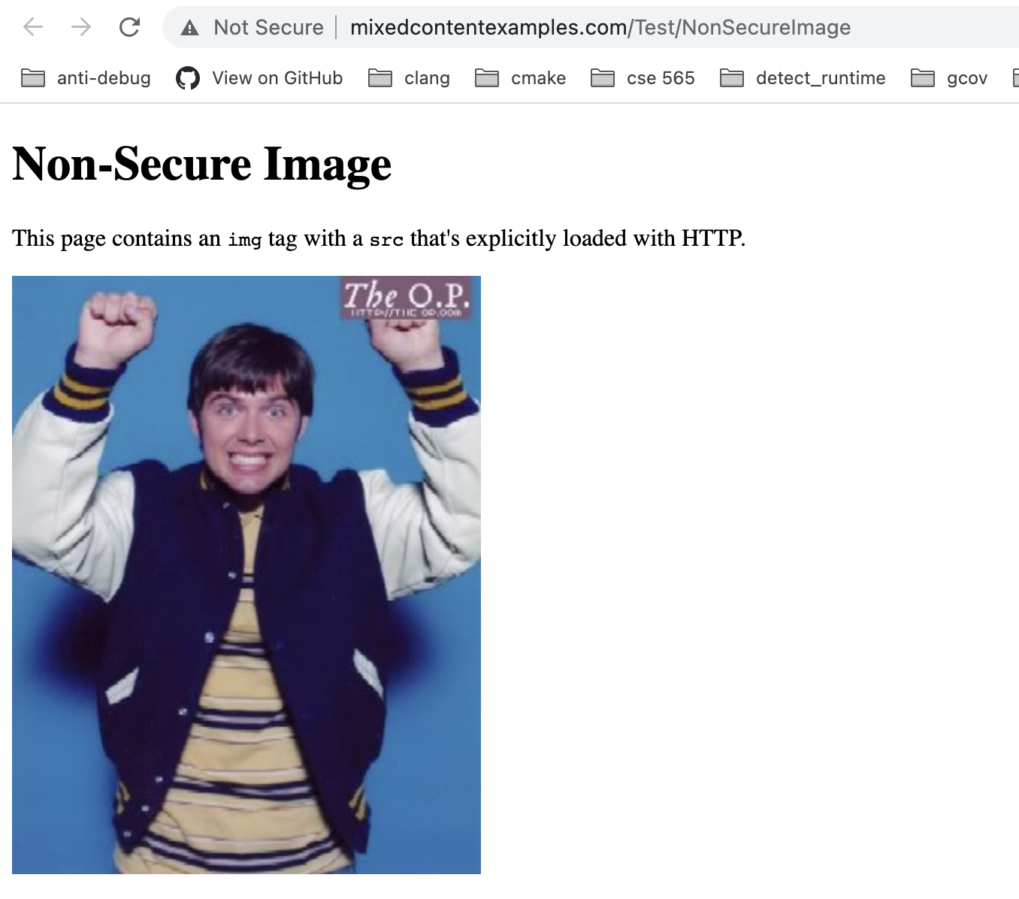
Origin Contamination: Today

Slide 41
More Fun with SSL
https://badssl.com

